Slide 1
Advanced Machine Learning

Slide 2
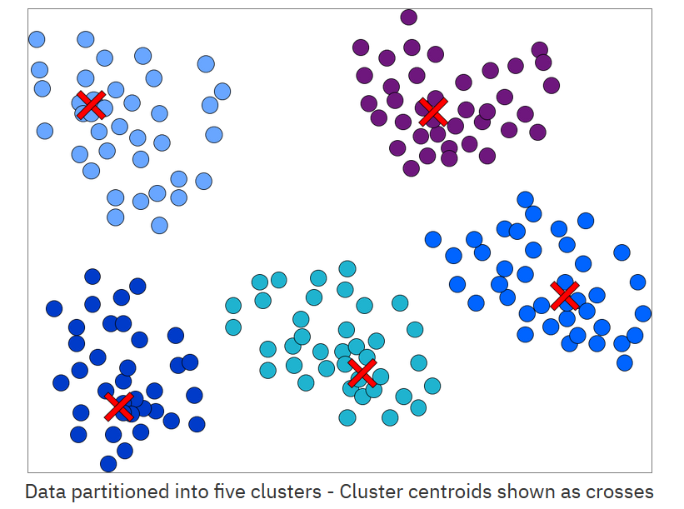
K-mean clustering
Unsupervised machine learning algorithm.
It groups a set of objects in such a way that objects in the same group (called a cluster) are more similar to each other than those in other groups (other clusters).
Notes:
K-means clustering is an unsupervised machine learning technique. The main goal of the algorithm is to group the data observations into k clusters, where each observation belongs to the cluster with the nearest mean.
A cluster’s center is the centroid. The figure shown plots of the partition of a data set into five clusters, with the cluster centroids shown as crosses.

Slide 3
K-means clustering (cont.)
Examples for applications include customer segmentation, image segmentation, and recommendation systems.
Notes:
Examples of applications include:
Customer segmentation: Imagine that you are the owner of electronics store. You want to understand preferences of your clients to expand your business. It is not possible to look at each client’s purchase details to find a good marketing strategy. But, you can group the details into, for example, five groups based on their purchasing habits. Then, you start building your marketing strategy for each group.
Image segmentation and compression: The process of partitioning a digital image into multiple segments (sets of pixels) to simplify and change the representation of an image into something that is more meaningful and easier to analyze. To achieve this task, we need a process that assigns a label to every pixel in an image such that pixels with the same label share certain features. The image in this slide is segmented and compressed into three regions by using k-means clustering. With smaller number of clusters, it provides more image compression but at the expense of less image quality.
Recommendation systems: These systems help you find users with the same preferences to build better recommendation systems.
References:
https://www.mathworks.com/help/examples/images/win64/SegmentGrayscaleImageUsingKMeansClusteringExample_02.png https://www.mathworks.com/help/examples/images/win64/SegmentGrayscaleImageUsingKMeansClusteringExample_01.png

Slide 4
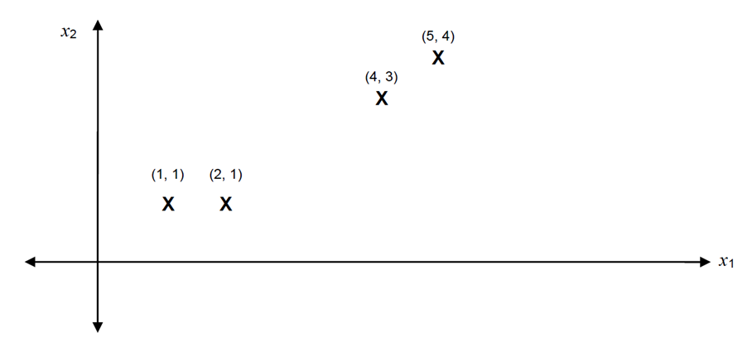
K-means clustering (cont.)
Example: Given the following data points, use K-means clustering to partition data into two clusters.
Notes:
Assume that you have the data points that are show in the figure. Your goal is to cluster each data point into one of two groups. Thus, the cluster size is 2. C1 and C2 represent these two clusters.

Slide 5
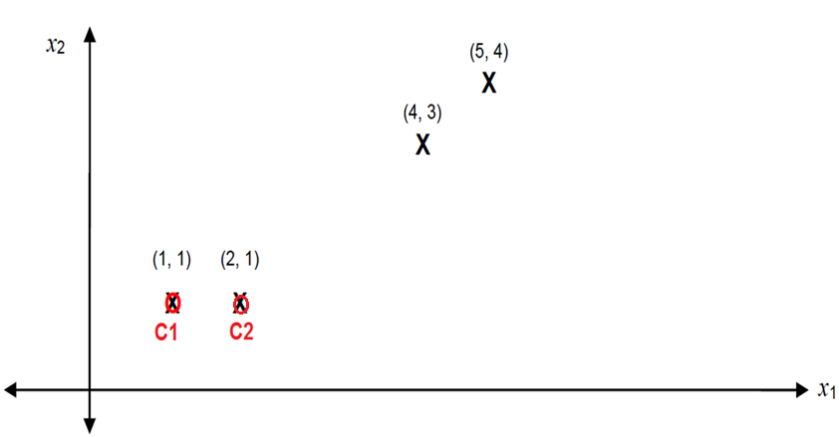
K-means clustering (cont.)
Set initial centroids are C1 (1,1) and C2 (2,1)
Notes:
Assume initial centroids are C1, point (1,1) and C2, point (2,1)

Slide 6
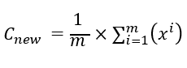
K-means clustering (cont.)
Find a new centroid by using→
Iteration 1:
Now, we calculate for each point to which center it belongs. The result depends on the distance between the center and the point (by using Euclidian distance):
Point 1: (1, 1) → d11 = Yes d12 = No
This means point1(2,2) belongs to C1 and not C2 because it is closer to C1.
Point 2: (2, 1) → d21 = No, d22 = Yes
Point 3: (4, 3) → d31 = No, d32 = Yes
Point 4: (5, 4) → d41 = No, d42 = Yes
Now, we calculate the new centroid as follows:
C1 = (1, 1)
C2 = 1/3 ((2, 1) + (4, 3) + (5, 4)) = (3.67, 2.67)
Notes:
To compute the centroid of a cluster, use an iterative process where each point is examined and you determine whether it belongs to a specific cluster. Then, you compute the new centroid by using the mean of all points.

Slide 7
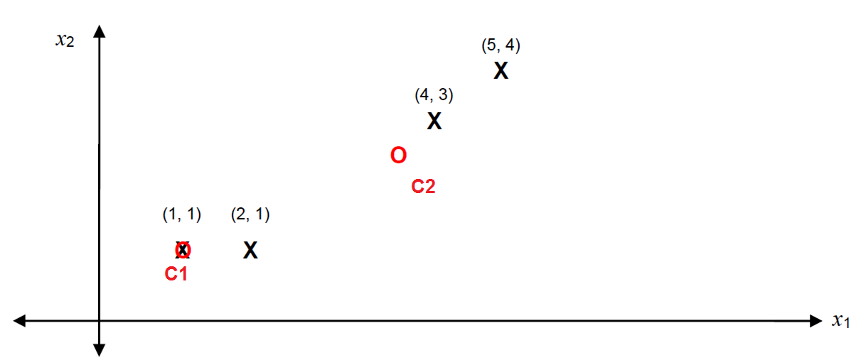
K-means clustering (cont.)
Notes:
As you see, the new points in red are the new centroids. We apply another iteration to find a better centroid that represents each cluster.

Slide 8
K-means clustering (cont.)
Iteration 2:
Point 1: (1, 1) → d11 = Yes, d12 = No
Point 2: (2, 1) → d21 = Yes, d22 = No
Point 3: (4, 3) → d31 = No, d32 = Yes
Point 4: (5, 4) → d41 = No, d42 = Yes
Now, we calculate the new centroid as follows:
C1 = 1/2 ((1, 1)+(2,1)) = (1.5,1)
C2 = 1/2 ((4, 3) + (5, 4)) = (4,5, 3.5)
Notes:
Now, we examine each point again against the centroid by using Euclidian distance and calculate the new centroids (C1 and C2).

Slide 9
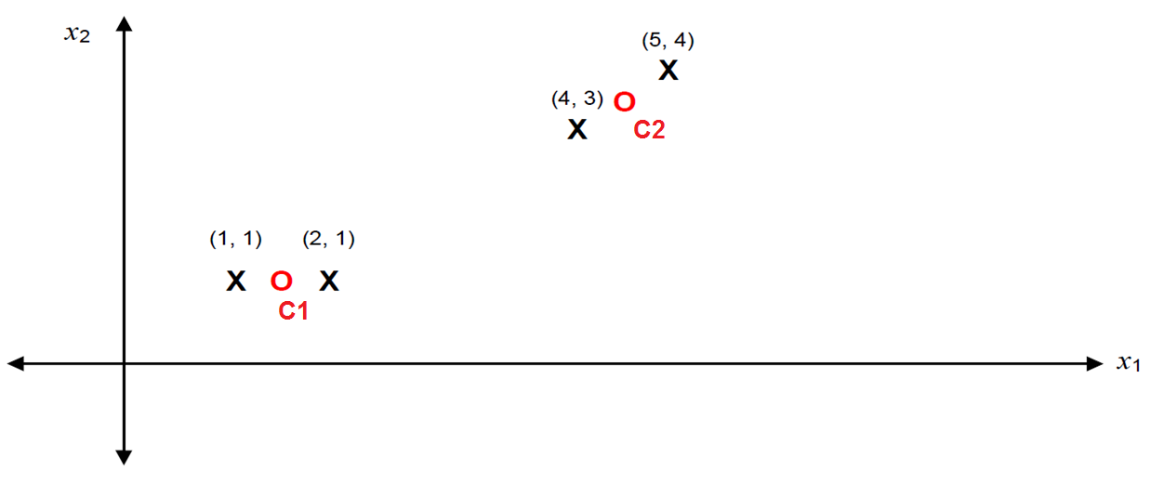
K-means clustering (cont.)
Notes:
As you see, the new red centroids represent the centers of the two clusters. The algorithm stops when the centroids do not change or change slightly, or if a maximum number of iterations are defined.

Slide 10
K-means Issues
Distance measure is squared Euclidean
Scale should be similar in all dimensions
Rescale data?
Not good for nominal data. Why?
Approach tries to minimize the within-cluster sum of squares error (WCSS)
Implicit assumption that SSE is similar for each group

Slide 11
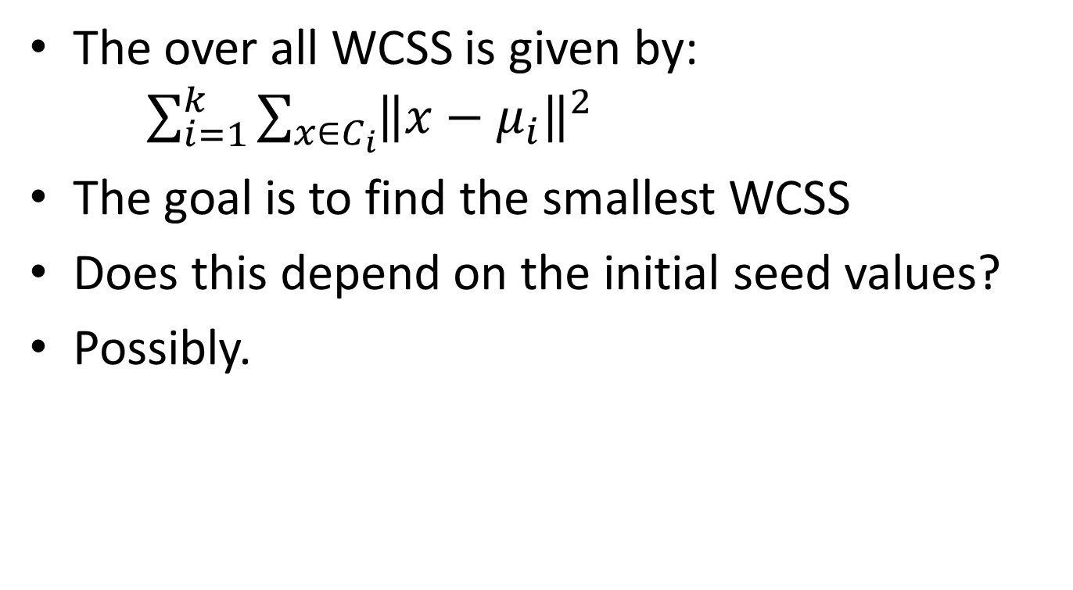
WCSS
The over all WCSS is given by: $\sum_{i=1}^{k}{\sum_{x∈C_{i}}{{\left\|x−μ_{i}\right\|}^{2}}}$
The goal is to find the smallest WCSS
Does this depend on the initial seed values?
Possibly.

Slide 12
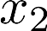
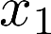
Data Compression
Reduce data from
2D to 1D
(inches)
(cm)
Andrew Ng

Slide 13
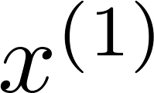
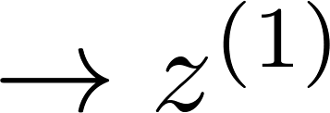
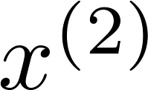
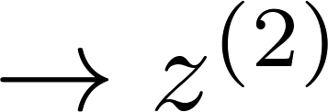
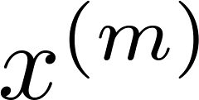
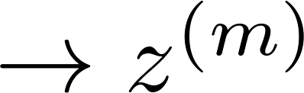
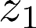
Data Compression
Reduce data from
2D to 1D
(inches)
(cm)
Andrew Ng
Notes:
Add more unique colors (3-4)

Slide 14
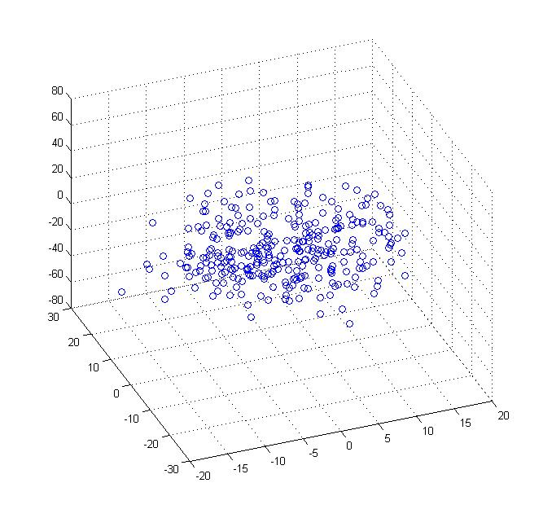
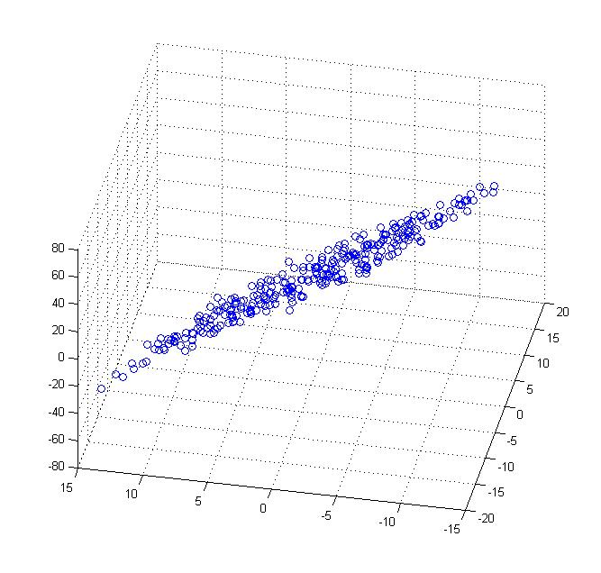
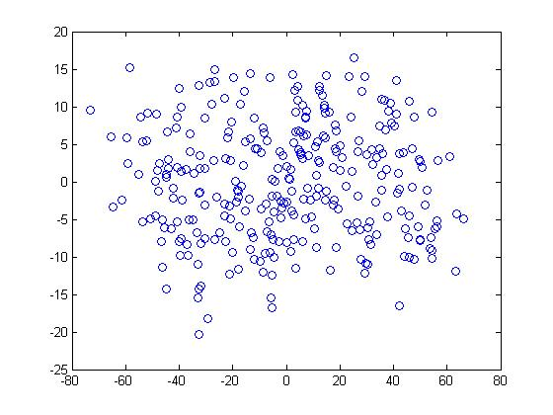
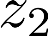
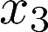
Data Compression
Reduce data from 3D to 2D
Andrew Ng
Notes:
Pca3d2d in lecture-slides/assets/pca/
Label axes

Slide 15

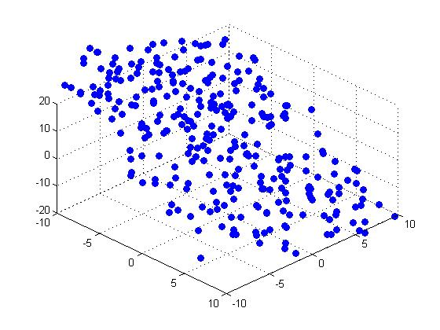

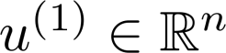
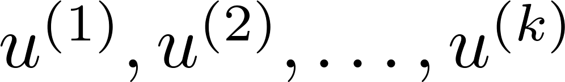
Principal Component Analysis (PCA) problem formulation
Reduce from 2-dimension to 1-dimension: Find a direction (a vector )
onto which to project the data so as to minimize the projection error.
Reduce from n-dimension to k-dimension: Find vectors
onto which to project the data, so as to minimize the projection error.
Andrew Ng
Notes:
Change numbers to LATEX as well

Slide 16
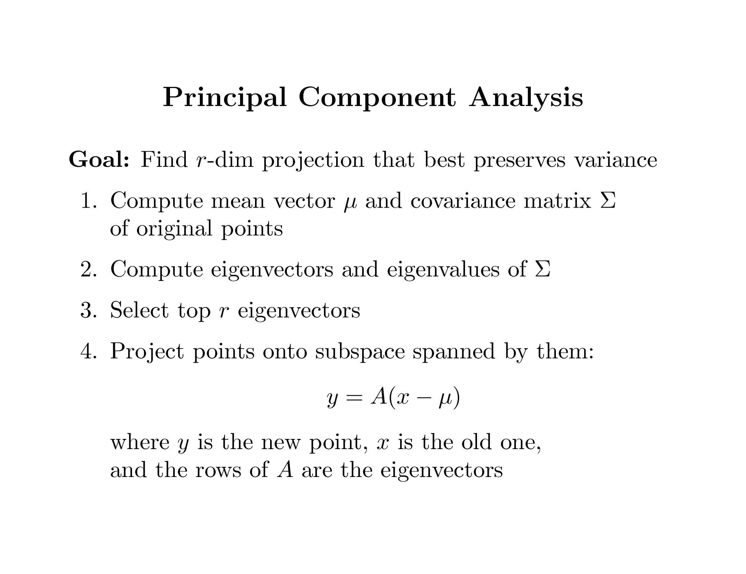

Slide 17
Covariance
Variance and Covariance:
Measure of the “spread” of a set of points around their center of mass(mean)
Variance:
Measure of the deviation from the mean for points in one dimension
Covariance:
Measure of how much each of the dimensions vary from the mean with respect to each other
Covariance is measured between two dimensions
Covariance sees if there is a relation between two dimensions
Covariance between one dimension is the variance

Slide 18
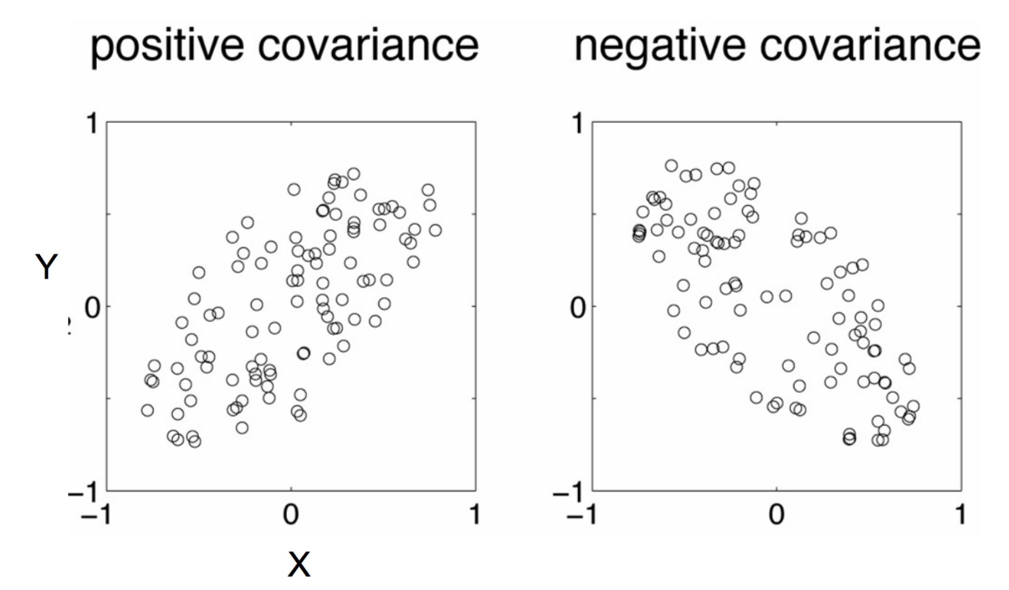
Positive: Both dimensions increase or decrease together
Negative: While one increase the other decrease

Slide 19
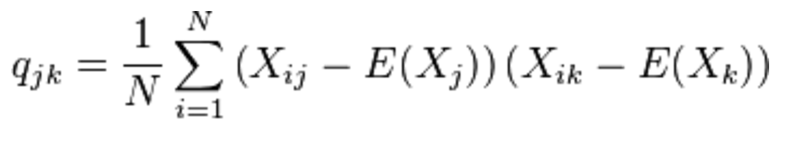
Covariance
Used to find relationships between dimensions in high dimensional data sets
The Sample mean

Slide 20
Eigenvector and Eigenvalue
Ax = λx
A: Square Matirx
λ: Eigenvector or characteristic vector
X: Eigenvalue or characteristic value
The zero vector can not be an eigenvector
The value zero can be eigenvalue

Slide 21
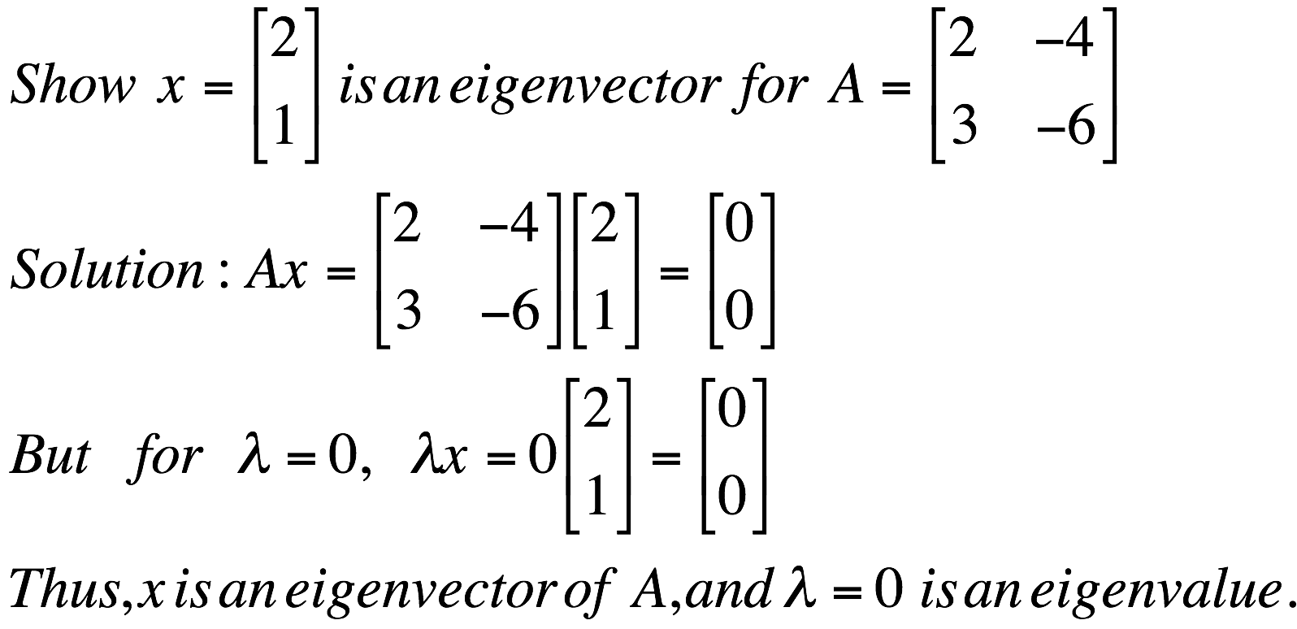
Eigenvector and Eigenvalue
Ax = λx
A: Square Matirx
λ: Eigenvector or characteristic vector
X: Eigenvalue or characteristic value
Example

Slide 22

Eigenvector and Eigenvalue
Ax - λx = 0
(A – λI)x = 0
Ax = λx
B = A – λI
Bx = 0
If we define a new matrix B:
x = B⁻¹0 = 0
BUT! an eigenvector cannot be zero!!
If B has an inverse:
x will be an eigenvector of A if and only if B does not have an inverse, or equivalently det(B)=0 :
det(A – λI) = 0

Slide 23
Eigenvector and Eigenvalue
Example 1: Find the eigenvalues of
two eigenvalues: −1, − 2
Note: The roots of the characteristic equation can be repeated. That is, λ₁ = λ₂ =…= λ_{k}. If that happens, the eigenvalue is said to be of multiplicity k.
Example 2: Find the eigenvalues of
λ = 2 is an eigenvector of multiplicity 3.

Slide 24
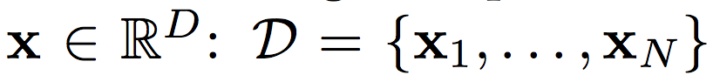
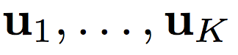
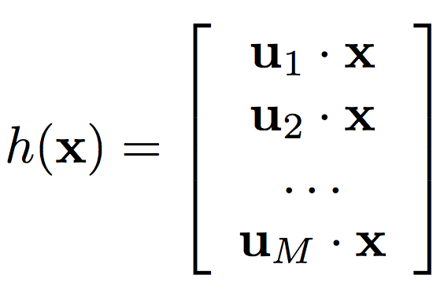
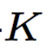
Principal Component Analysis
Input:
Set of basis vectors:
Summarize a D dimensional vector X with K dimensional feature vector h(x)

Slide 25
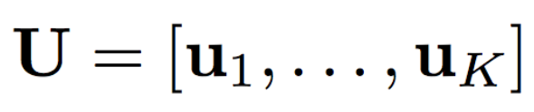
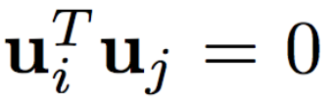
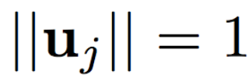
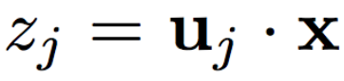
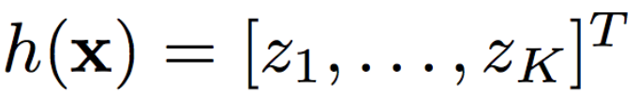
Principal Component Analysis
Basis vectors are orthonormal
New data representation h(x)

Slide 26
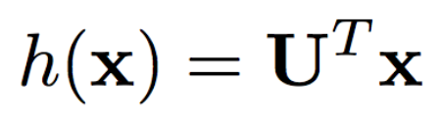
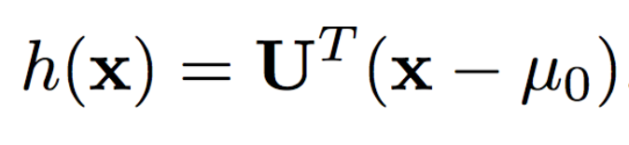
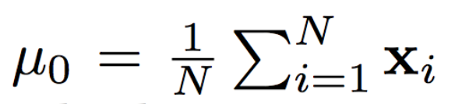
Principal Component Analysis
New data representation h(x)
Empirical mean of the data

Slide 27
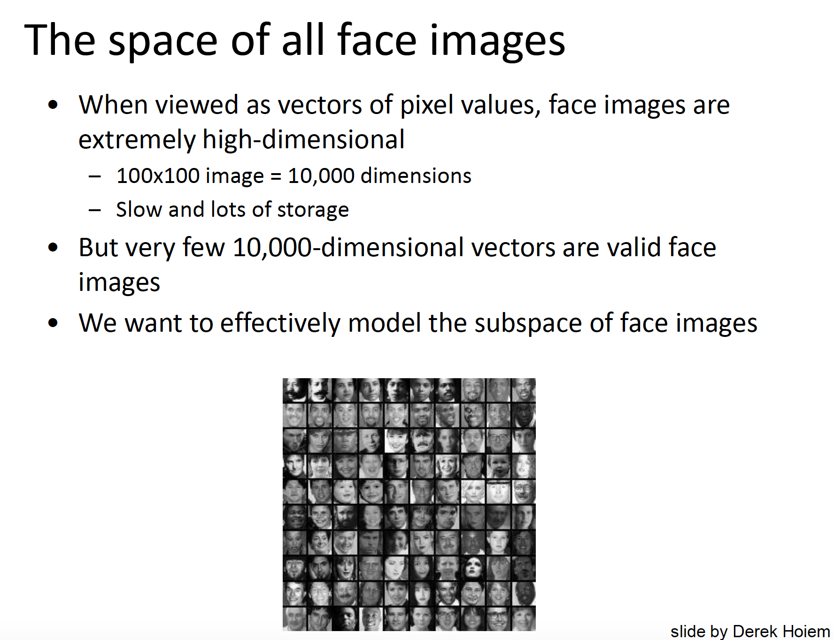

Slide 28
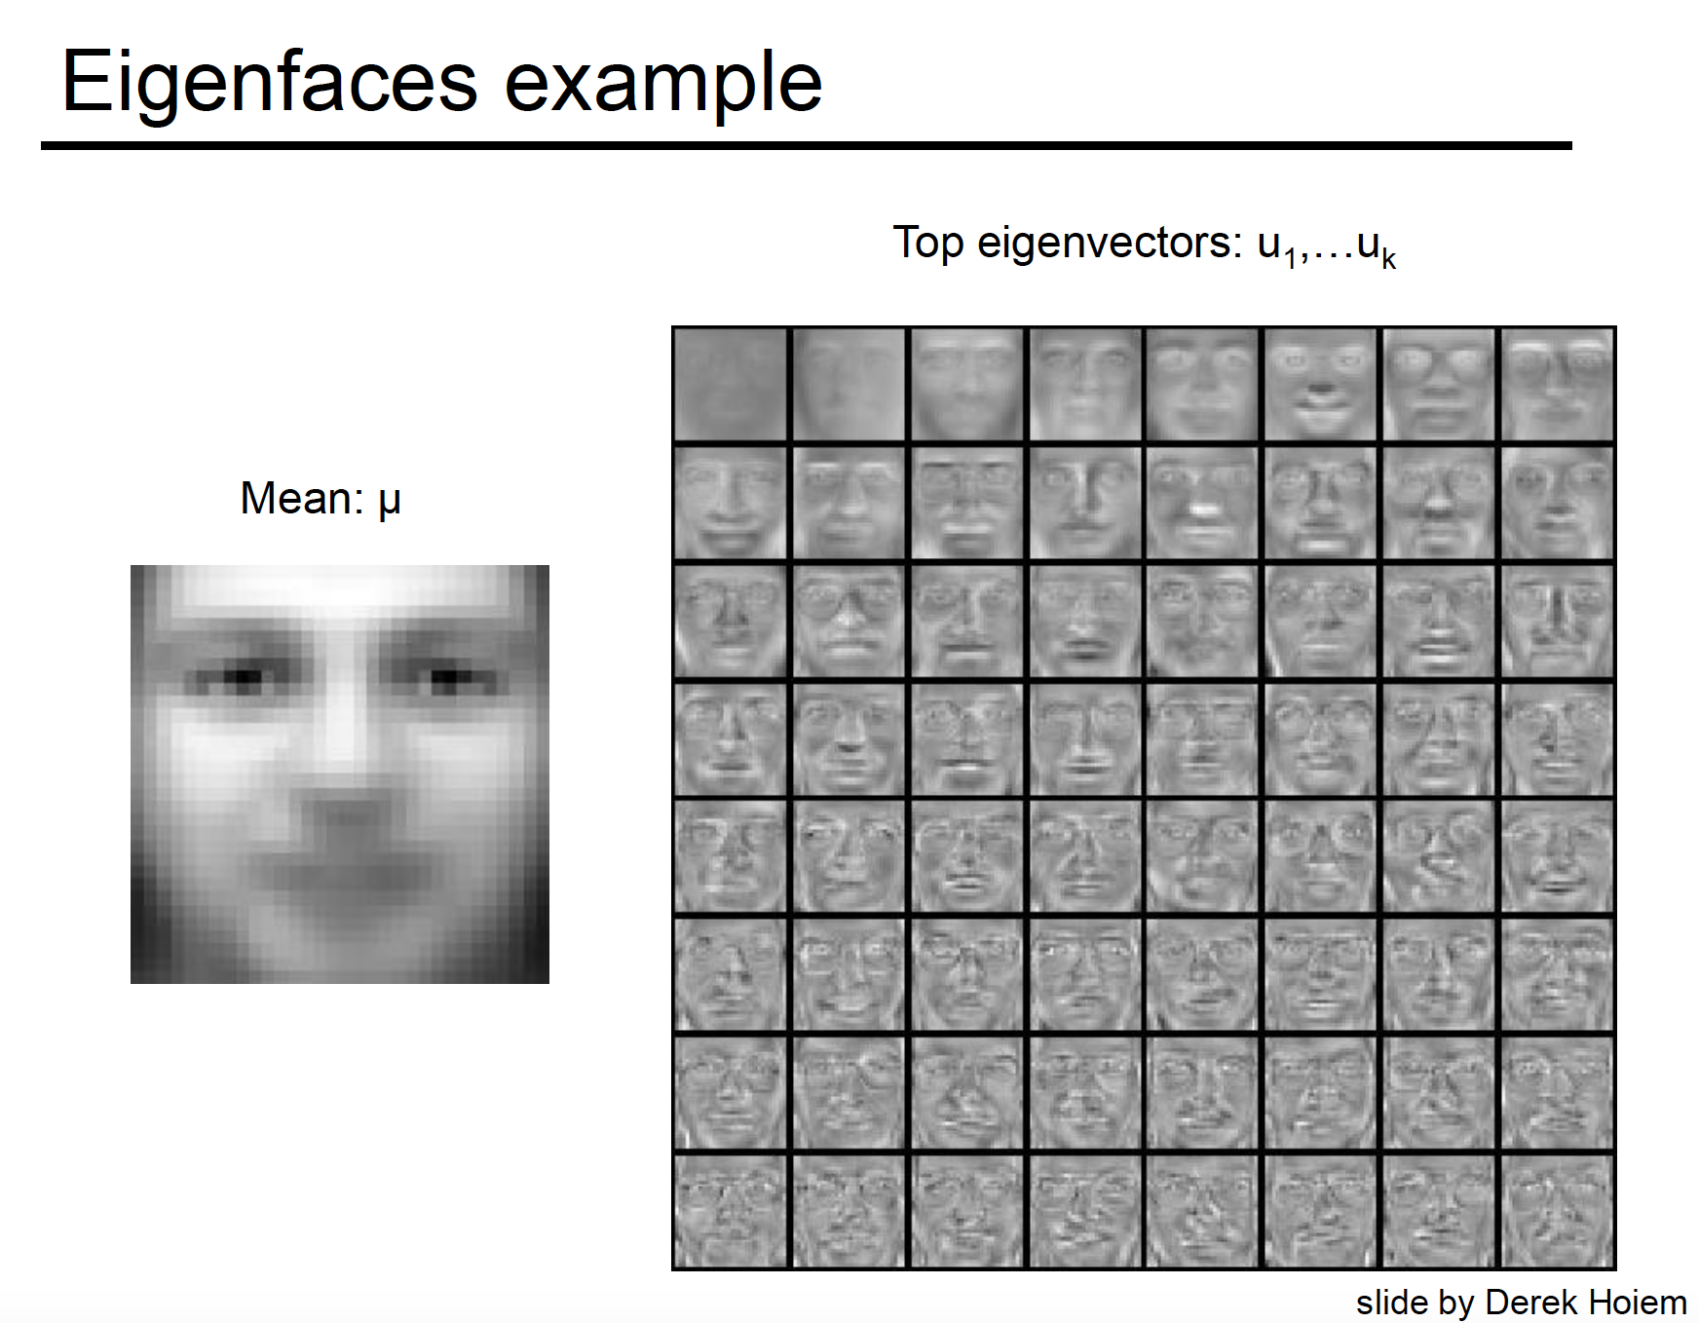

Slide 29
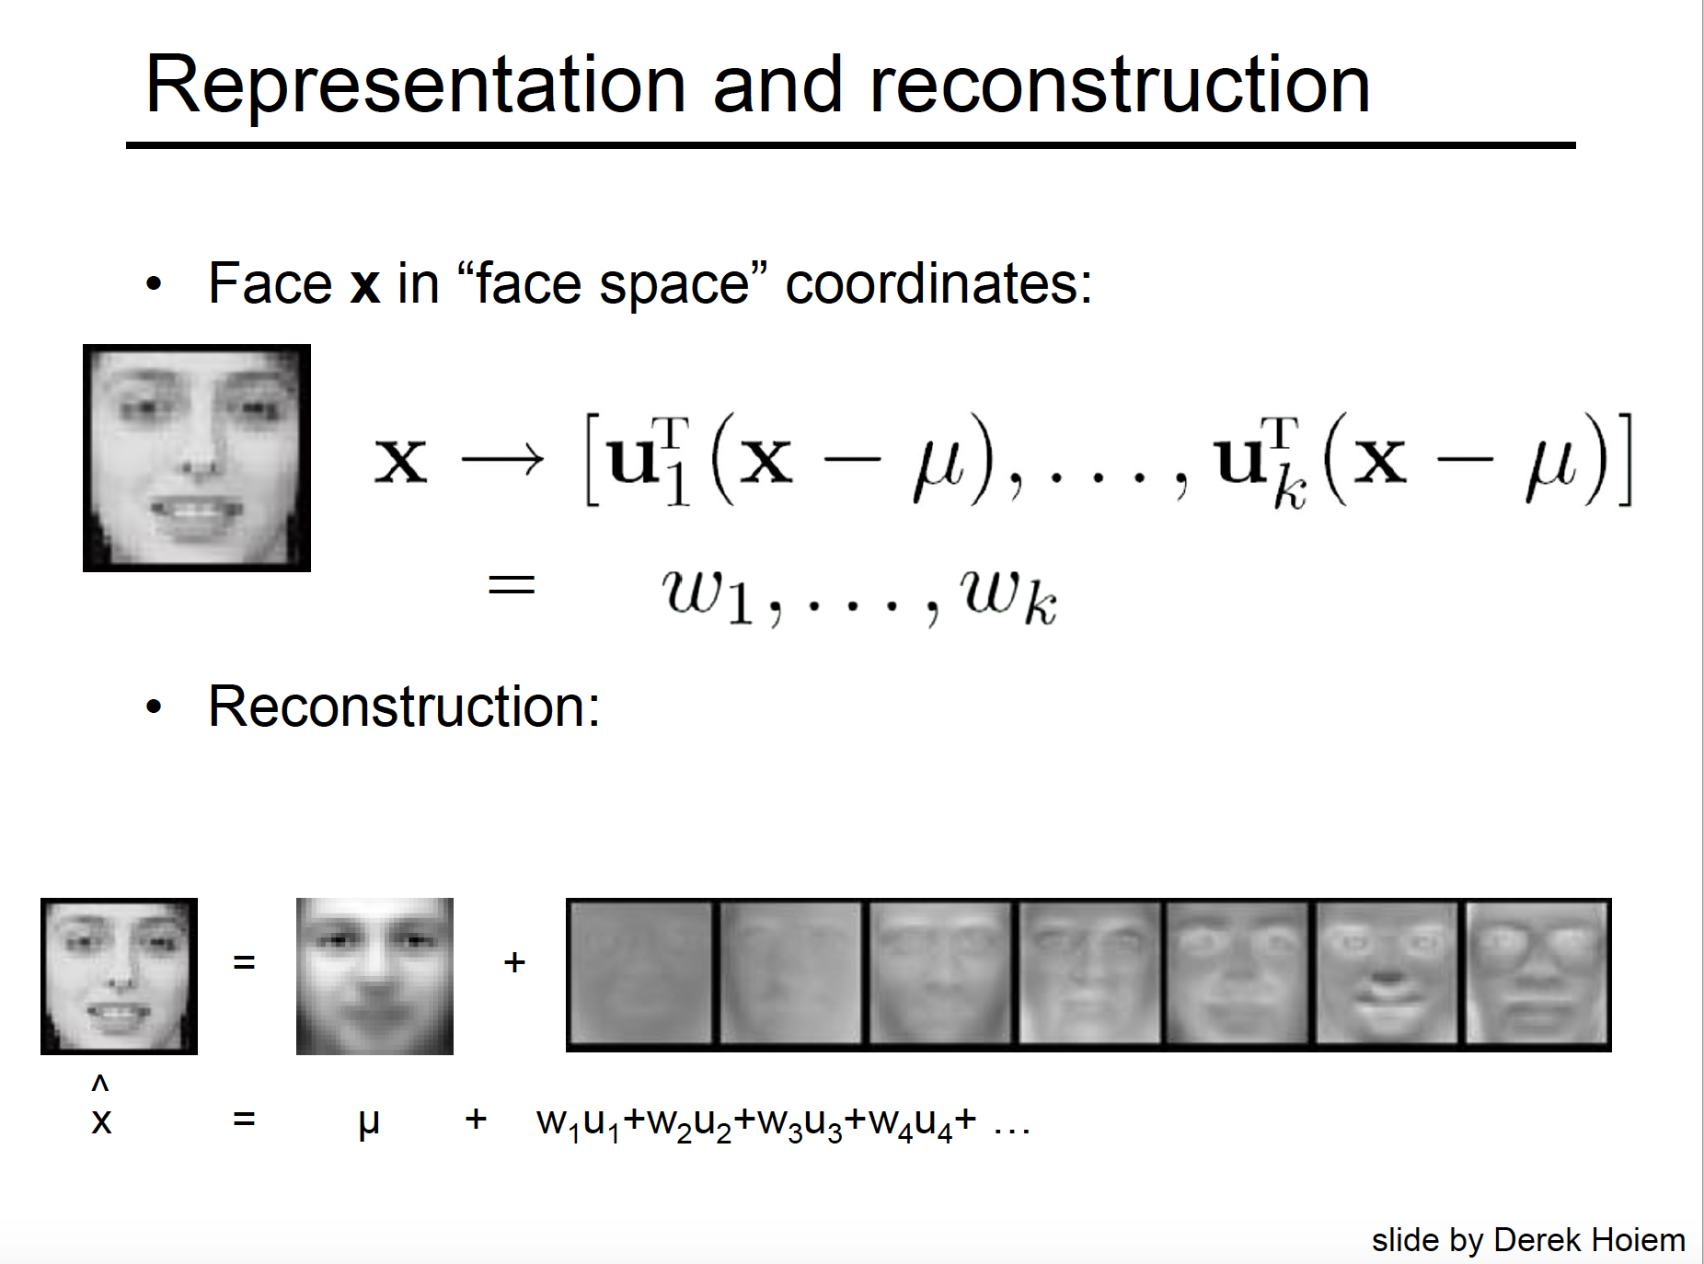

Slide 30
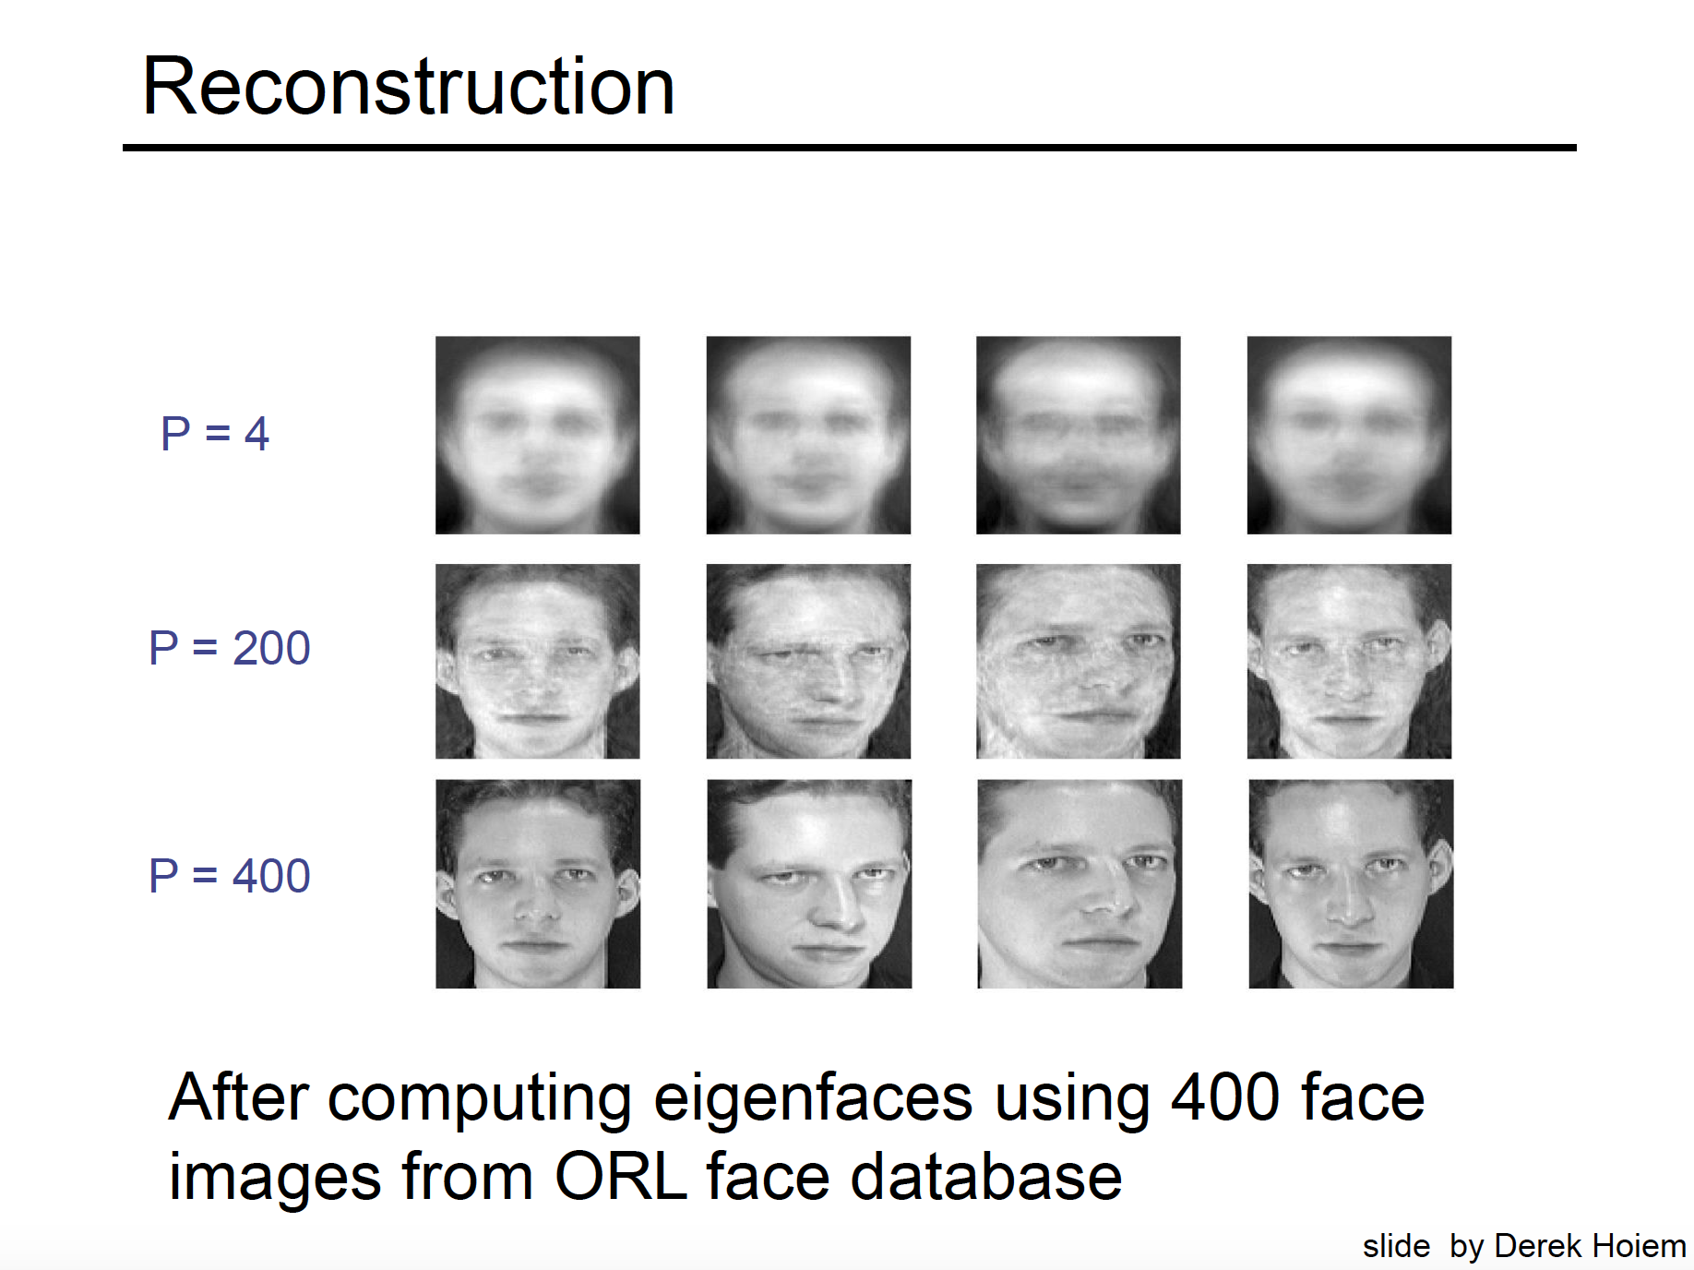

Slide 31
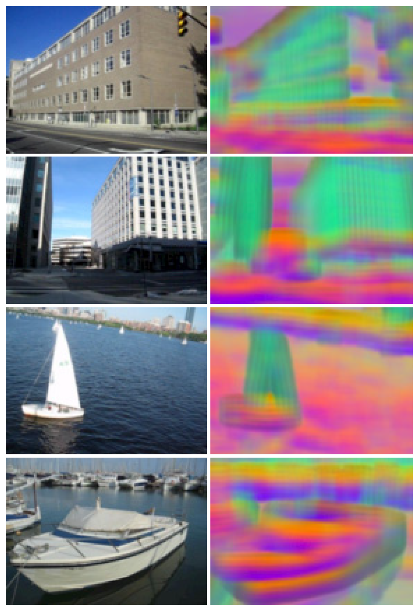
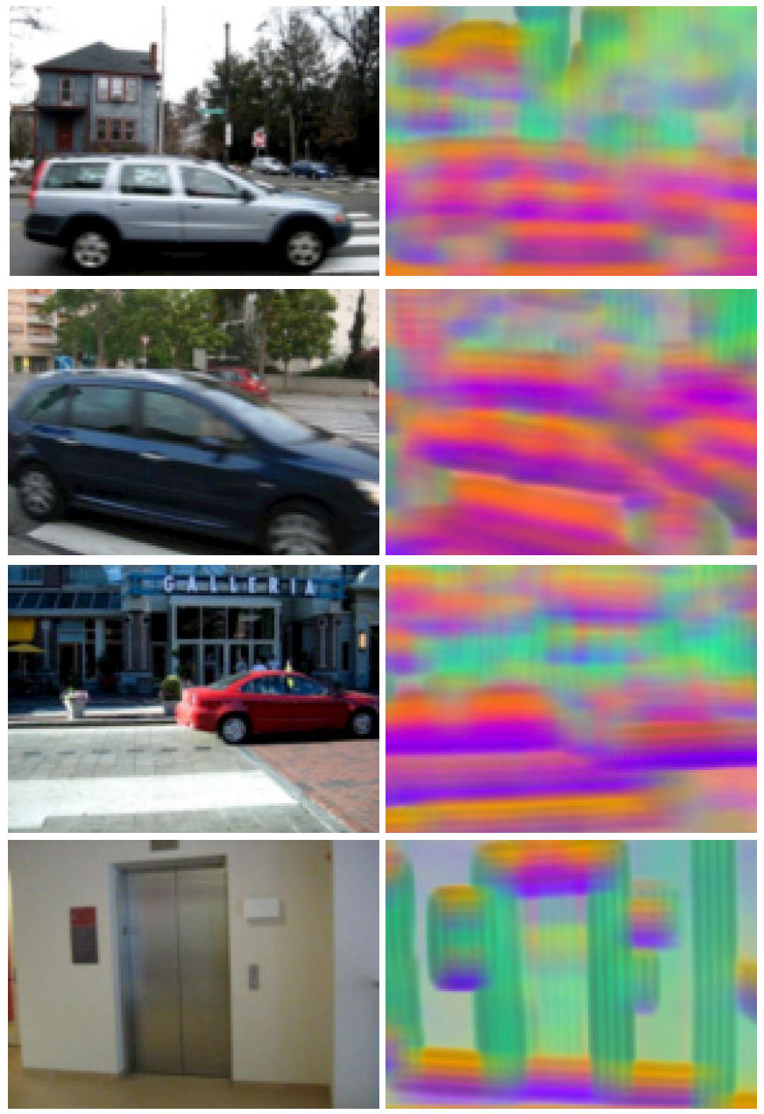
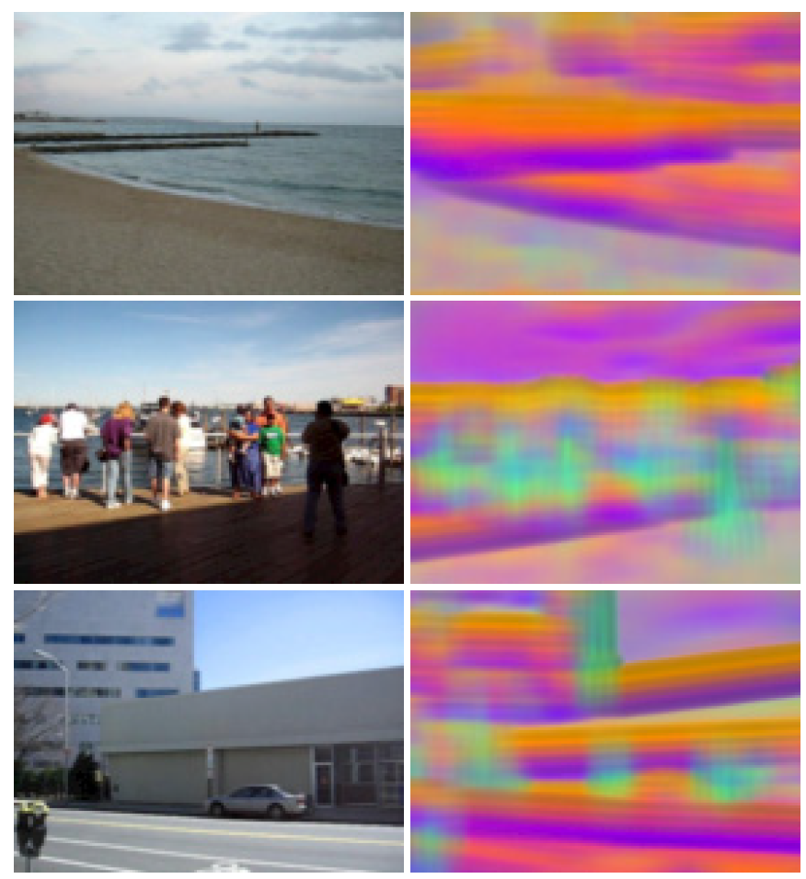
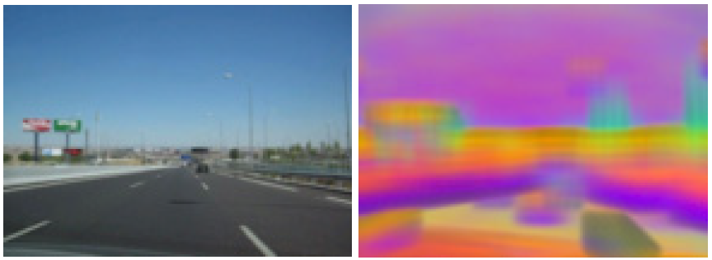
SIFT feature visualization
The top three principal components of SIFT descriptors from a set of images are computed
Map these principal components to the principal components of the RGB space
pixels with similar colors share similar structures

Slide 32
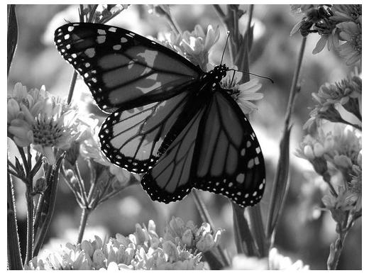
Original Image
Application: Image compression
Divide the original 372x492 image into patches:
Each patch is an instance that contains 12x12 pixels on a grid
View each as a 144-D vector

Slide 33

PCA compression: 144D → 60D

Slide 34

PCA compression: 144D → 16D

Slide 35
16 most important eigenvectors

Slide 36
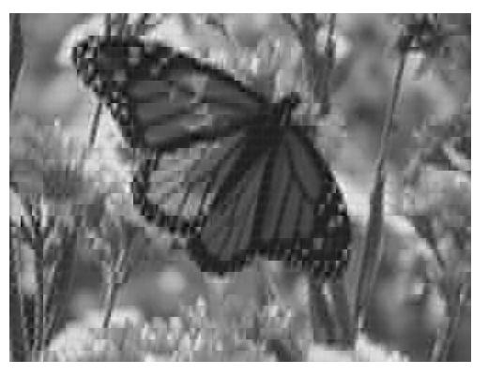
PCA compression: 144D ) 6D

Slide 37
6 most important eigenvectors

Slide 38

PCA compression: 144D → 3D

Slide 39
3 most important eigenvectors

Slide 40

PCA compression: 144D → 1D

Slide 41
The Gaussian Mixture Model (GMM)
We will estimate p(x) as a weighted sum of Gaussians
Formally:
When N denotes the normal (or Gaussian) distribution
The π_{k} weights are non-negative and add up to 1
The number K of the Gaussians is fixed (but it could be optimized as well)
By increasing the number of components the curve defined by the mixture model can take basically any shape, so it is much more flexible than just one Gaussian
Examples:

Slide 42


Examples #1

Slide 43


Examples #2

Slide 44
Parameter estimation for GMMs
The parameters of the model are π_{k} , μ_{k} and Σ_{k} for all components (k=1,..,K). Sometimes we will again use a short notation for all the parameters: θ=(π₁, μ₁ , Σ₁,…, π_{K}, μ_{K} , Σ_{K})
We again seek to maximize the log-likelihood function:
When p(x) was just a Gaussian curve, we could simply take its derivative and find its zero point
Unfortunately, obtaining the derivative of the mixture model is much more difficult
So we will need some other solution – this will be the EM algorithm

Slide 45


Parameter estimation for GMMs
Let’s take the log-likelihood function
And try to set its derivative to zero (e.g. with respect to μ_{k}):
It doesn’t work ☹
In the case of just one Gaussian, the logarithm helped get rid of the exponential function
But now there is a summation between the logarithm and the exponential
This is the problem (it contains μ_{k})
Derivative of 1 Gaussian (same as before)

Slide 46

Alternative idea – let’s divide the samples into disjunct groups
Example: we want to fit a mixture of 2 Gaussians on the green points
Let’s divide the points into 2 disjunct groups (clusters) – see the purple curves
We can perform this division using the K-means clustering algorithm
We can now easily fit 1-1 Gaussian on both clusters!
Using the ML method GMM

Slide 47
The iterative EM training process
What do we have now?
We can easily fit the Gaussians (estimate μ_{k} and Σ_{k} ) if the responsibilities are given
We can easily calculate the responsibilities if the Gaussians (μ_{k} and Σ_{k} ) are given
We can turn it into an iterative process – the EM process
0. step: Initialization of μ_{k} and Σ_{k} (randomly, or by K-means)
1. step (E step or Estimation step): estimate the responsibilities
2. step (M step or Maximization step): maximize the log-likelihood of each Gaussian by re-calculating μ_{k} and Σ_{k}
Go back to step 1 (μ_{k} and Σ_{k} changed, so we must re-calculate the responsibilities!)

Slide 48

Examples
Example 1 (with random initialization):

Slide 49
AIC (Akaike information criterion) and BIC (Bayesian Information Criterion)
AIC is an estimate of a constant plus the relative distance between the unknown true likelihood function of the data and the fitted likelihood function of the model
BIC is an estimate of a function of the posterior probability of a model being true, under a certain Bayesian setup.
They consist of a goodness-of-fit term plus a penalty to control over-fitting, and provide a standardized way to balance between having enough parameters to adequately model the relationships among variables in the population (sensitivity) and not over-fitting a model or suggesting non existent relationships (specificity); hence the smaller the AIC/BIC, the better the model.

